Slide 1
battle of neighbourhoods
-analysis of toronto

Slide 2

content
Introduction
Data
Methodology
Result and Conclusion

Slide 3
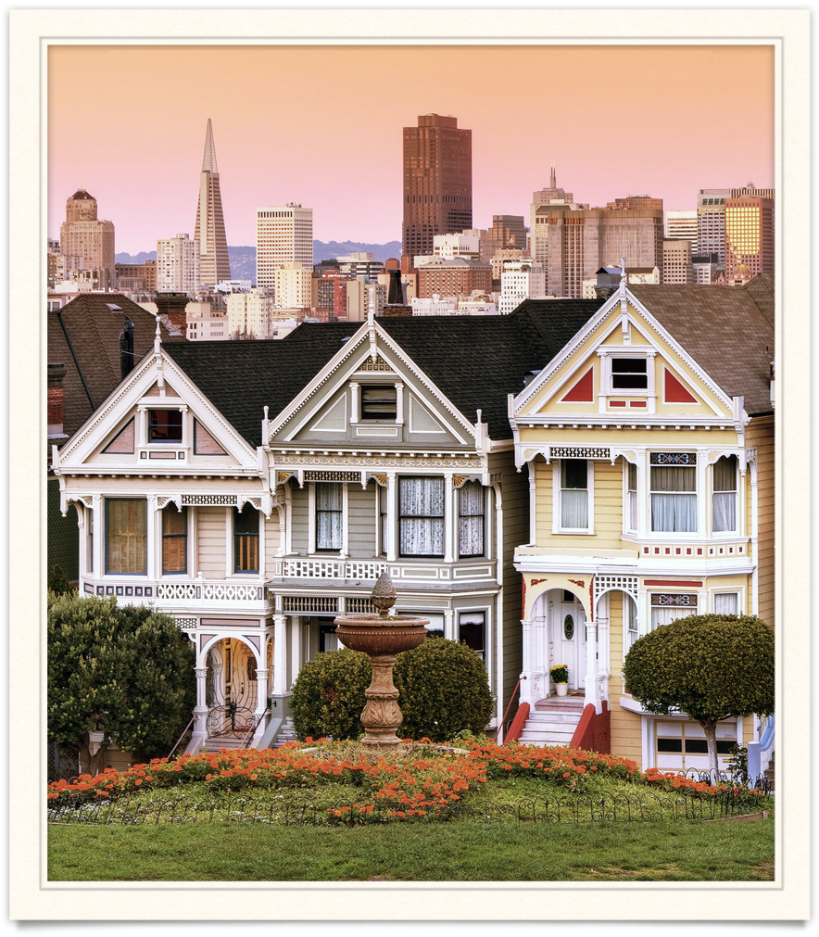
introduction
main factors
population
education
house price
venues
users
new immigrants
real-estate companies
investors

Slide 4

Dataset
I used ‘https://en.wikipedia.org/wiki/Demographics_of_Toronto_neighbourhoods’ in wiki to create of population density.choropleth map
I used https://www.compareschoolrankings.org to get the ranking of elementary school in Toronto
I used ‘Crime in Toronto’ in wiki to get the crime map of Toronto.
I used Forsquare API to get the restaurant, parkland other living facilities given Borough of Toronto.

Slide 5
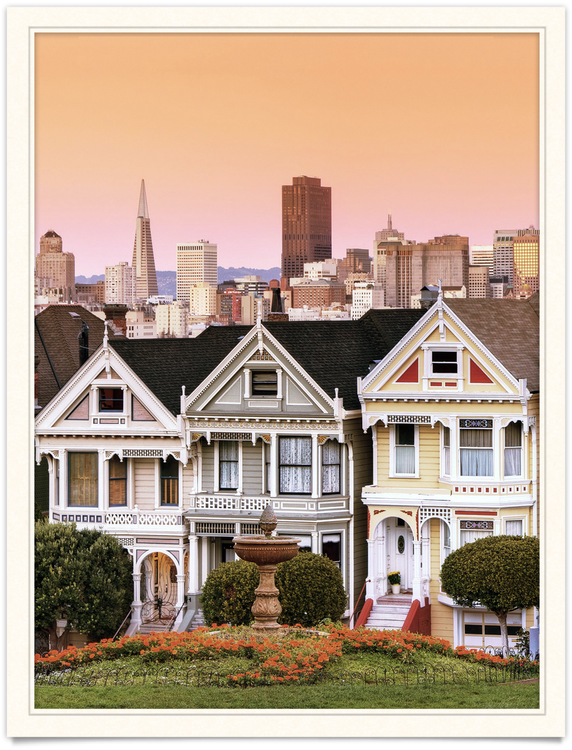
methodology
dataset

Slide 6
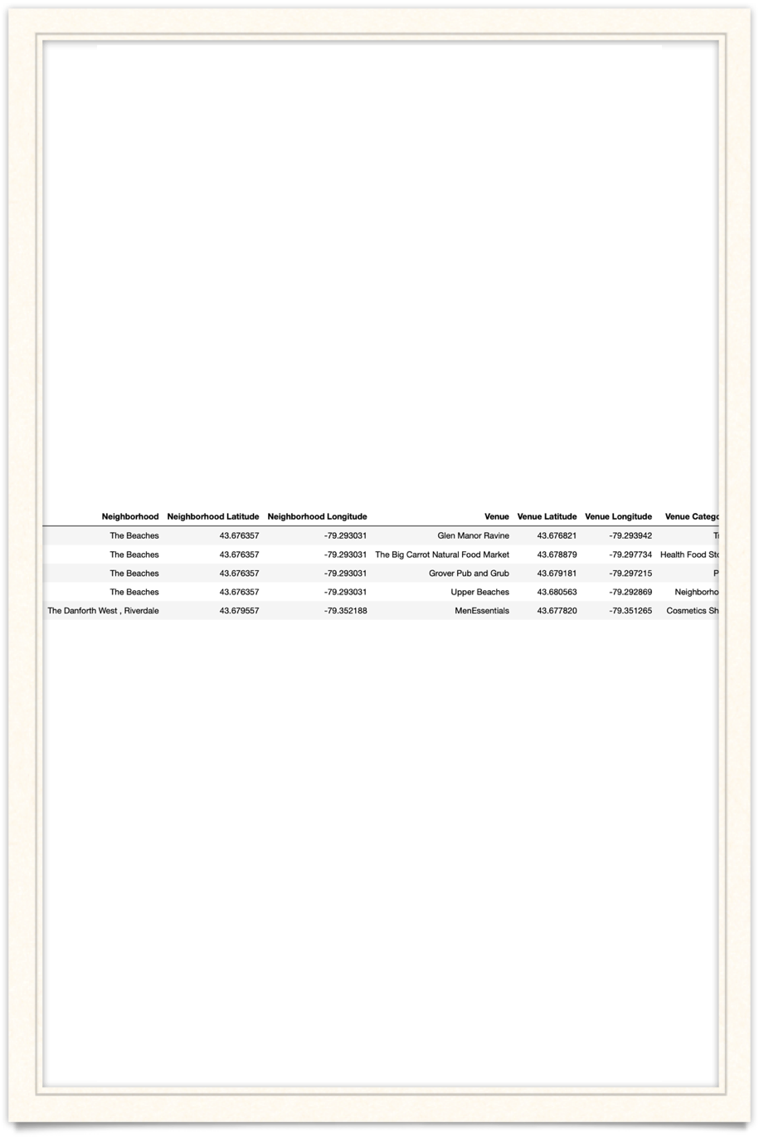
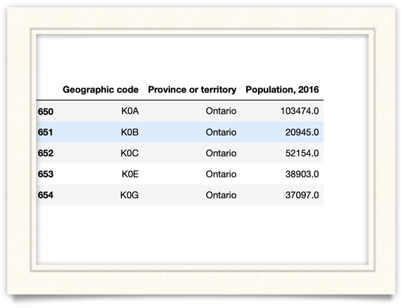
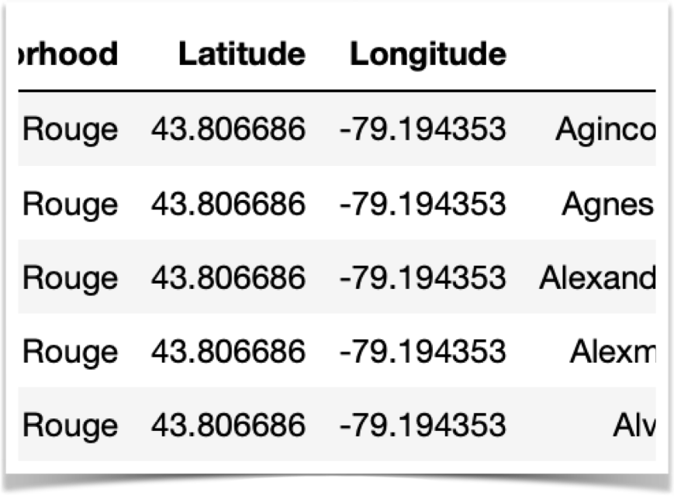

Slide 7
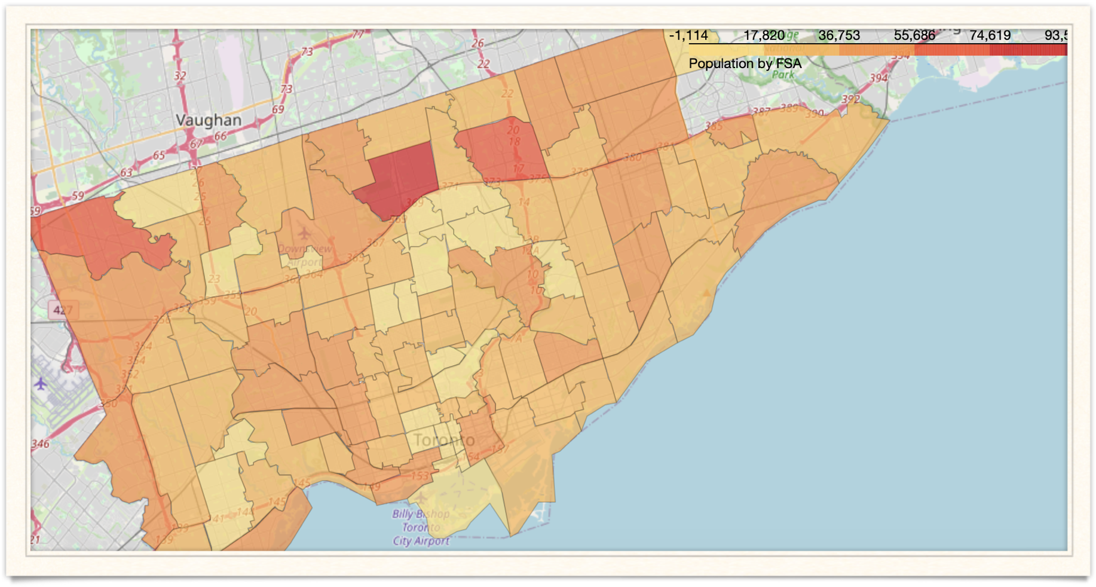
methodology
-map

Slide 8
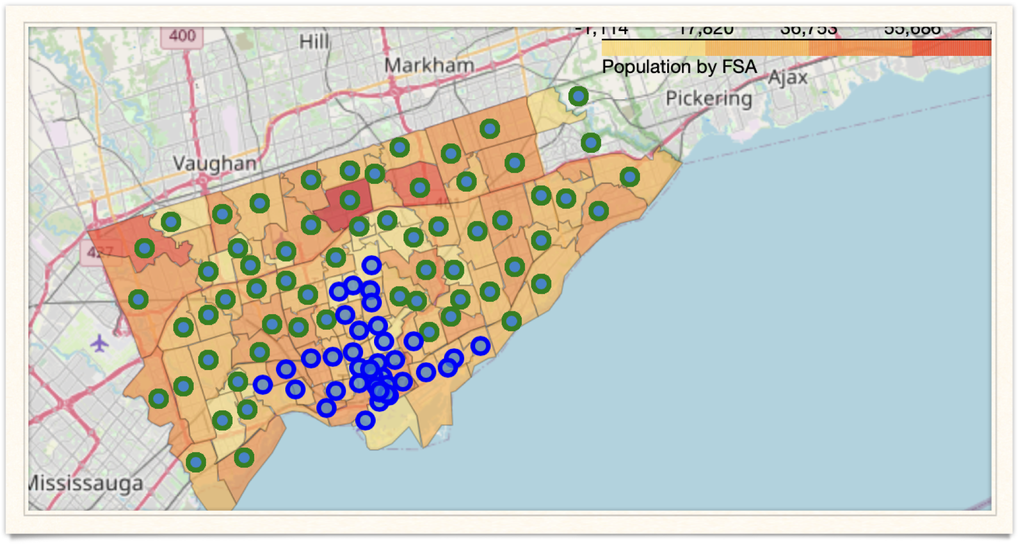
methodology
-map

Slide 9
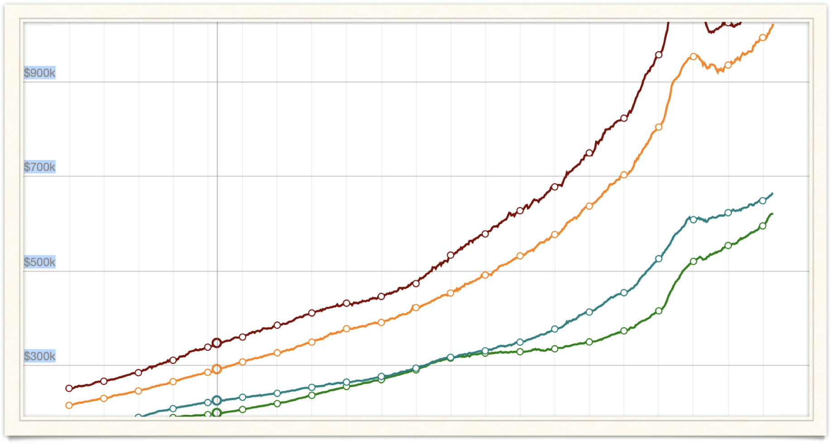
methodology
-trend

Slide 10
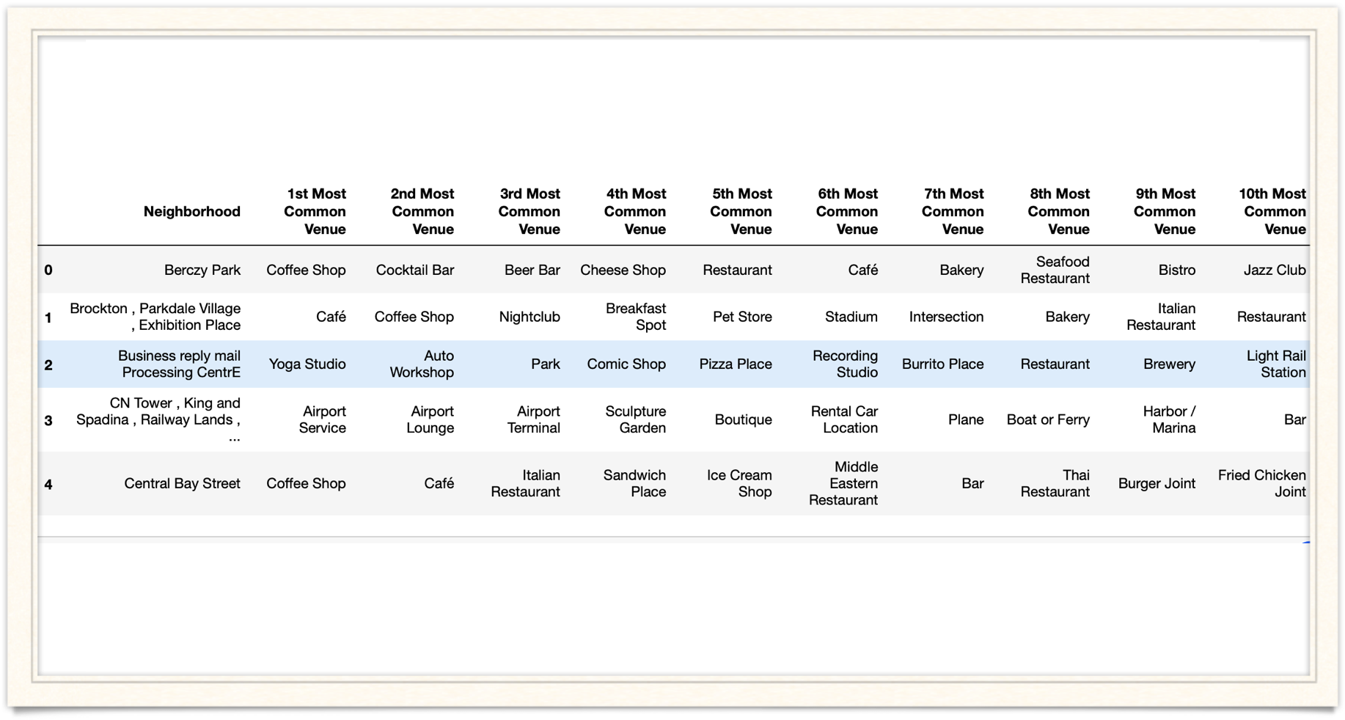
methodology
-top 10 venues

Slide 11
Result and Conclusion
higher population usually along with the more venues
the house pricing is more related with the education and living environment.
there are tons of data that may impact on different people, the data visualizing would be an efficient way
future study will focus on analysis of relationships between different data and data visualization

